Slide 1

Session 03
Variables and Data Types

Slide 2
Objectives
Define and describe statements and expressions
Explain the types of operators
Explain the process of performing data conversions in C#

Slide 3
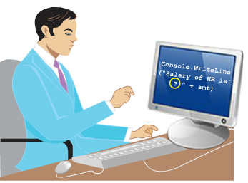
Statements and Expressions
A C# program is a set of tasks that perform to achieve the overall functionality of the program.
To perform the tasks, programmers provide instructions. These instructions are called statements.
A C# statement can contain expressions that evaluates to a value.

Slide 4
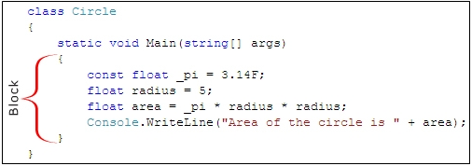
Statements - Definition
Statements are referred to as logical grouping of variables, operators, and C# keywords that perform a specific task.
For example, the line which initializes a variable by assigning it a value is a statement.
In C#, a statement ends with a semicolon.
A C# program contains multiple statements grouped in blocks. A block is a code segment enclosed in curly braces.
For example, the set of statements included in the Main() method of a C# code is a block.
The following figure displays an example of a block of statements:

Slide 5
Statements – Uses 1-3
Statements are used to specify the input, the process, and the output tasks of a program. Statements can consist of:
Data types
Variables
Operators
Constants
Literals
Keywords
Escape sequence characters
Statements help you build a logical flow in the program. With the help of statements, you can:
Initialize variables and objects
Take the input
Call a method of a class
Display the output

Slide 6
Statements – Uses 2-3
The following code shows an example of a statement in C#:
This line of code is an example of a C# statement that calculates the area of the circle and stores the value in the variable area.
The following code shows an example of a block of statements in C#.
In the code:
A block of code is enclosed within curly braces.
The first statement from the top will be executed first followed by the next statement and so on.
Snippet
double area = 3.1452 * radius * radius;
{
int side = 10;
int height = 5;
double area = 0.5 * side * height;
Console.WriteLine(“Area: ” , area);
}
Snippet

Slide 7
Statements – Uses 3-3
The following code shows an example of nested blocks in C#:
In the code:
Another block of code is nested within a block of statements.
The first three statements from the top will be executed in sequence.
Then, the line of code within the inside braces will be executed to calculate the area.
The execution is terminated at the last statement in the block of the code displaying the area.
{
int side = 5;
int height = 10;
double area;
{
area = 0.5 * side * height;
}
Console.WriteLine(area);
}
Snippet

Slide 8
Types of Statements
Similar to statements in C and C++, the C# statements are classified into seven categories:
Selection Statements
Iteration Statements
Jump Statements
Exception Handling Statements
Checked and Unchecked Statements
Fixed Statement
Lock Statement

Slide 9
Checked and Unchecked Statements 1-4
Following are the features of the checked and unchecked statements:
A checked statement creates a checked context for a block of statements and has the following form:
checked-statement:
checked block
The checked statement checks for an arithmetic overflow in arithmetic expressions and the unchecked statement does not check for an arithmetic overflow.
An arithmetic overflow occurs if the result of an expression or a block of code is greater than the range of the target variable’s data type causing the program to throw an exception that is caught by the OverflowException class.
Exceptions are runtime errors that disrupt the normal flow of the program.
The System.Exception class is used to derive several exception classes that handle the different types of exceptions.
The checked statement is associated with the checked keyword. When an arithmetic overflow occurs, the checked statement halts the execution of the program.

Slide 10
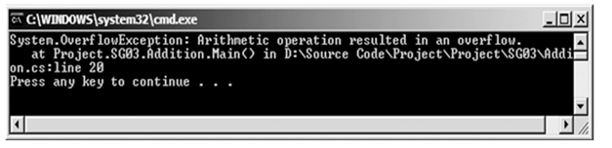
Checked and Unchecked Statements 2-4
The following code creates a class Addition with the checked statement that throws an overflow exception.
Snippet
using System;
class Addition
{
public static void Main()
{
byte numOne = 255;
byte numTwo = 1;
byte result = 0;
try
{
//This code throws an overflow // exception checked
{
result = (byte)(numOne + numTwo);
}
Console.WriteLine("Result: " +
result);
}
catch (OverflowException ex)
{
Console.WriteLine(ex);
}
}
}
When the statement in the checked block is executed, it gives an error. This is because the result of the addition of the two numbers results in 256. This value is too large to be stored in the byte variable causing an arithmetic overflow to occur.
Output

Slide 11
Checked and Unchecked Statements 3-4
The unchecked statement is associated with the unchecked keyword.
The unchecked statement ignores the arithmetic overflow and assigns junk data to the target variable.
An unchecked statement creates an unchecked context for a block of statements and has the following form:
unchecked-statement:
unchecked block

Slide 12
Checked and Unchecked Statements 4-4
The following code creates a class Addition that uses the unchecked statement:
In the code:
When the statement within the unchecked block is executed, the overflow that is generated is ignored by the unchecked statement and it returns an unexpected value.
The checked and unchecked statements are similar to the checked and unchecked operators.
The only difference is that the statements operate on blocks instead of expressions.
using System;
class Addition
{
public static void Main()
{
byte numOne = 255;
byte numTwo = 1;
byte result = 0;
try
{
unchecked
{
result = (byte)(numOne + numTwo);
}
Console.WriteLine("Result: " + result);
}
catch (OverflowException ex)
{
Console.WriteLine(ex);
}
}
}
Snippet

Slide 13
Expressions – Definition
Expressions are used to manipulate data. Like in mathematics, expressions in programming languages, including C#, are constructed from the operands and operators.
An expression statement in C# ends with a semicolon (;).
Expressions are used to:
Produce values.
Produce a result from an evaluation.
Form part of another expression or a statement.
The following code demonstrates an example for expressions:
In the first two lines of code, the results of the statements are stored in the variables SimpleInterest and eval. The last statement increments the value of the variable num.
Snippet
simpleInterest = principal * time * rate / 100;
eval = 25 + 6 – 78 * 5;
num++;

Slide 14
Differences between Statements and Expressions
Some fundamental differences between statements and expressions are listed in the table.
Statements | Expressions
Do not necessarily return values. For example, consider the following statement: int oddNum = 5; The statement only stores the value 5 in the oddNum variable. | Always evaluates to a value. For example, consider the following expression: 100*(25*10) The expression evaluates to the value 2500.
Statements are executed by the compiler. | Expressions are part of statements and are evaluated by the compiler.

Slide 15
Operators
Following are the features of operators in C#:
Expressions in C# comprise one or more operators that performs some operations on variables.
An operation is an action performed on single or multiple values stored in variables in order to modify them or to generate a new value with the help of minimum one symbol and a value.
The symbol is called an operator and it determines the type of action to be performed on the value.
The value on which the operation is to be performed is called an operand.
An operand might be a complex expression. For example, (X * Y) + (X – Y) is a complex expression, where the + operator is used to join two operands.

Slide 16
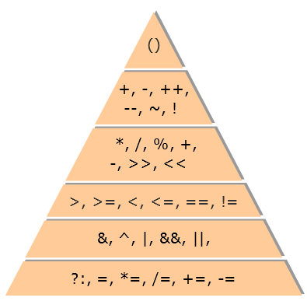
Types of Operators
Operators are used to simplify expressions.
In C#, there is a predefined set of operators used to perform various types of operations.
These are classified into six categories based on the action they perform on values:
Arithmetic Operators
Relational Operators
Logical Operators
Conditional Operators
Increment and Decrement Operators
Assignment Operators

Slide 17
Arithmetic Operators – Types 1-2
Arithmetic operators are binary operators because they work with two operands, with the operator being placed in between the operands.
These operators allow you to perform computations on numeric or string data.
The following table lists the arithmetic operators along with their descriptions and an example of each type:
Operators | Description | Examples
+ (Addition) | Performs addition. If the two operands are strings, then it functions as a string concatenation operator and adds one string to the end of the other. | 40 + 20
- (Subtraction) | Performs subtraction. If a greater value is subtracted from a lower value, the resultant output is a negative value. | 100 - 47
* (Multiplication) | Performs multiplication. | 67 * 46
/ (Division) | Performs division. The operator divides the first operand by the second operand and gives the quotient as the output. | 12000 / 10
% (Modulo) | Performs modulo operation. The operator divides the two operands and gives the remainder of the division operation as the output. | 100 % 33

Slide 18
Arithmetic Operators – Types 2-2
The following code demonstrates how to use the arithmetic operators:
Addition 12
Subtraction 8
Multiplication 20
Division 5
Remainder 0
Snippet
int valueOne = 10;
int valueTwo = 2;
int add = valueOne + valueTwo;
int sub = valueOne - valueTwo;
int mult = ValueOne * valueTwo;
int div = valueOne / valueTwo;
int modu = valueOne % valueTwo;
Console.WriteLine(“Addition ” + add );
Console.WriteLine(“Subtraction ” + sub);
Console.WriteLine(“Multiplication ” + mult);
Console.WriteLine(“Division ” + div);
Console.WriteLine(“Remainder ” + modu);
Output

Slide 19
Relational Operators 1-2
Relational operators make a comparison between two operands and return a boolean value, true, or false.
The following table lists the relational operators along with their descriptions and an example of each type.
Relational Operators | Description | Examples
== | Checks whether the two operands are identical. | 85 == 95
!= | Checks for inequality between two operands. | 35 != 40
> | Checks whether the first value is greater than the second value. | 50 > 30
< | Checks whether the first value is lesser than the second value. | 20 < 30
>= | Checks whether the first value is greater than or equal to the second value. | 100 >= 30
<= | Checks whether the first value is lesser than or equal to the second value. | 75 <= 80

Slide 20
Relational Operators 2-2
The following code demonstrates how to use the relational operators.
Equal: False
Not Equal: True
Greater: False
Lesser: True
Greater or Equal: False
Lesser or Equal: True
Snippet
int leftVal = 50;
int rightVal = 100;
Console.WriteLine(“Equal: ” + (leftVal == rightVal));
Console.WriteLine(“Not Equal: ” + (leftVal != rightVal));
Console.WriteLine(“Greater: ” + (leftVal > rightVal));
Console.WriteLine(“Lesser: ” + (leftVal < rightVal));
Console.WriteLine(“Greater or Equal: ” + (leftVal >= rightVal));
Console.WriteLine(“Lesser or Equal: ” + (leftVal <= rightVal));
Output

Slide 21
Logical Operators 1-7
Logical operators are binary operators that perform logical operations on two operands and return a boolean value.
C# supports two types of logical operators:
Boolean Logical Operators
Bitwise Logical Operators

Slide 22
Logical Operators 2-7
Boolean Logical Operators:
Boolean logical operators perform boolean logical operations on both the operands. They return a boolean value based on the logical operator used.
The following table lists the boolean logical operators along with their descriptions and an example of each type:
Logical Operators | Description | Examples
& (Boolean AND) | Returns true if both the expressions are evaluated to true. | (percent >= 75) & (percent <= 100)
| (Boolean Inclusive OR) | Returns true if at least one of the expressions is evaluated to true. | (choice == ‘Y’) | (choice == ‘y’)
^ (Boolean Exclusive OR) | Returns true if only one of the expressions is evaluated to true. If both the expressions evaluate to true, the operator returns false. | (choice == ‘Q’) ^ (choice == ‘q’)

Slide 23
Logical Operators 3-7
The following code explains the use of the boolean inclusive OR operator:
In the code:
The boolean inclusive OR operator checks both the expressions.
If either one of them evaluates to true, the complete expression returns true and the statement within the block is executed.
The following code explains the use of the boolean AND operator:
In the code:
The boolean AND operator checks both the expressions.
If both the expressions evaluate to true, the complete expression returns true and the statement within the block is executed.
Snippet
if ((quantity > 2000) | (price < 10.5))
{
Console.WriteLine (“You can buy more goods at a lower price”);
}
Snippet
if ((quantity == 2000) & (price == 10.5))
{
Console.WriteLine (“The goods are correctly priced”);
}

Slide 24
Logical Operators 4-7
The following code explains the use of the boolean exclusive OR operator:
In the code:
The boolean exclusive OR operator checks both the expressions.
If only one of them evaluates to true, the complete expression returns true and the statement within the block is executed.
If both of them are true, the expression returns false.
Snippet
if ((quantity == 2000) ^ (price == 10.5))
{
Console.WriteLine (“You have to compromise between
quantity and price”);
}

Slide 25
Logical Operators 5-7
Bitwise Logical Operators:
The bitwise logical operators perform logical operations on the corresponding individual bits of two operands.
The following table lists the bitwise logical operators along with their descriptions and an example of each type:
The following code explains the working of the bitwise AND operator:
Logical Operators | Description | Examples
& (Bitwise AND) | Compares two bits and returns 1 if both bits are 1, else returns 0. | 00111000 & 00011100
| (Bitwise Inclusive OR) | Compares two bits and returns 1 if either of the bits is 1. | 00010101 | 00011110
^ (Bitwise Exclusive OR) | Compares two bits and returns 1 if only one of the bits is 1. | 00001011 ^ 00011110
Snippet
result = 56 & 28; //(56 = 00111000 and 28 = 00011100)
Console.WriteLine(result);

Slide 26
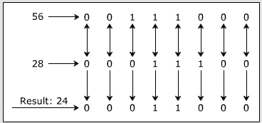
Logical Operators 6-7
In the code:
The bitwise AND operator compares the corresponding bits of the two operands.
It returns 1 if both the bits in that position are 1 or else returns 0.
This comparison is performed on each of the individual bits and the results of these comparisons form an 8-bit binary number.
This number is automatically converted to integer, which is displayed as the output. The resultant output for the code is “24”.
The following figure displays the bitwise logical operators:

Slide 27
Logical Operators 7-7
The following code explains the working of the bitwise inclusive OR operator:
In the code:
The bitwise inclusive OR operator compares the corresponding bits of the two operands.
It returns 1 if either of the bits in that position is 1, else it returns 0.
This comparison is performed on each of the individual bits and the results of these comparisons form an 8-bit binary number.
This number is automatically converted to integer, which is displayed as the output and the resultant output for the code is 60.
The following code explains the working of the bitwise exclusive OR operator:
In the code:
The bitwise exclusive OR operator compares the corresponding bits of the two operands.
It returns 1 if only 1 of the bits in that position is 1, else it returns 0.
This comparison is performed on each of the individual bits and the results of these comparisons form an 8-bit binary number.
This number is automatically converted to integer, which is displayed as the output. The resultant output for the code is 36.
Snippet
result = 56 | 28;
Console.WriteLine(result);
Snippet
result = 56 ^ 28;
Console.WriteLine(result);

Slide 28
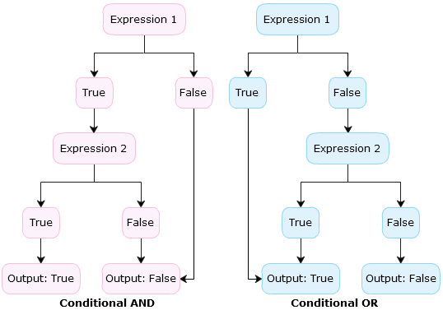
Conditional Operators 1-3
There are two types of conditional operators, conditional AND (&&) and conditional OR (||).
Conditional operators are similar to the boolean logical operators but have the following differences:
The conditional AND operator evaluates the second expression only if the first expression returns true because this operator returns true only if both expressions are true.
The conditional OR operator evaluates the second expression only if the first expression returns false because this operator returns true if either of the expressions is true.

Slide 29
Conditional Operators 2-3
The following code displays the use of the conditional AND (&&) operator:
Snippet
int num = 0;
if (num >= 1 && num <= 10)
{
Console.WriteLine(“The number exists between 1 and 10”);
}
else
{
Console.WriteLine(“The number does not exist between 1 and 10”);
}
In the code:
The conditional AND operator checks the first expression.
The first expression returns false, therefore, the operator does not check the second expression.
The whole expression evaluates to false, the statement in the else block is executed.
The number does not exist between 1 and 10
Output

Slide 30
Conditional Operators 3-3
The following code displays the use of the conditional OR (||) operator:
The number does not exist between 1 and 10.
In the code:
The conditional OR operator checks the first expression.
The first expression returns true, therefore, the operator does not check the second expression.
The whole expression evaluates to true, the statement in the if block is executed.
int num = -5;
if (num < 0 || num > 10)
{
Console.WriteLine(“The number does not exist between 1 and 10”);
}
else
{
Console.WriteLine(“The number exists between 1 and 10”);
}
Snippet
Output

Slide 31
Increment and Decrement Operators
Two of the most common calculations performed in programming are increasing and decreasing the value of the variable by 1.
In C#, the increment operator (++) is used to increase the value by 1 while the decrement operator (--) is used to decrease the value by 1.
If the operator is placed before the operand, the expression is called pre-increment or pre-decrement.
If the operator is placed after the operand, the expression is called post-increment or post-decrement.
The following table depicts the use of increment and decrement operators assuming the value of the variable valueOne is 5:
Expression | Type | Result
valueTwo = ++ValueOne; | Pre-Increment | valueTwo = 6
valueTwo = valueOne++; | Post-Increment | valueTwo = 5
valueTwo = --valueOne; | Pre-Decrement | valueTwo = 4
valueTwo = valueOne--; | Post-Decrement | valueTwo = 5

Slide 32
Assignment Operators – Types 1-2
Assignment operators are used to assign the value of the right side operand to the operand on the left side using the equal to operator (=).
The assignment operators are divided into two categories in C#. These are as follows:
Simple assignment operators: The simple assignment operator is =, which is used to assign a value or result of an expression to a variable.
Compound assignment operators: The compound assignment operators are formed by combining the simple assignment operator with the arithmetic operators.
The following table shows the use of assignment operators assuming the value of the variable valueOne is 10:
Expression | Description | Result
valueOne += 5; | valueOne = valueOne + 5 | valueOne = 15
valueOne -= 5; | valueOne = valueOne - 5 | valueOne = 5
valueOne *= 5; | valueOne = valueOne * 5 | valueOne = 50
valueOne %= 5; | valueOne = valueOne % 5 | valueOne = 0

Slide 33
Assignment Operators – Types 2-2
The following code demonstrates how to use assignment operators.
Value1 =5
Value1 += 4= 9
Value1 -= 8= 1
Value1 *= 7= 7
Value1 /= 2= 3
Value1 == Value2: False
Snippet
int valueOne = 5;
int valueTwo = 10;
Console.WriteLine(“Value1 =” + valueOne);
valueOne += 4;
Console.WriteLine(“Value1 += 4= “ + valueOne);
valueOne -= 8;
Console.WriteLine(“Value1 -= 8= “ + valueOne);
valueOne *= 7;
Console.WriteLine(“Value1 *= 7= “ + valueOne);
valueOne /= 2;
Console.WriteLine(“Value1 /= 2= “ + valueOne);
Console.WriteLine(“Value1 == Value2: {0}”, (valueOne == valueTwo));
Output

Slide 34
Precedence and Associativity 1-2
Operators in C# have certain associated priority levels.
The C# compiler executes operators in the sequence defined by the priority level of the operators.
The multiplication operator (*) has higher priority over the addition (+) operator. Thus, if an expression involves both the operators, the multiplication operation is carried out before the addition operation. In addition, the execution of the expression (associativity) is either from left to right or vice-versa depending upon the operators used.
The following table lists the precedence of the operators, from the highest to the lowest precedence, their description and their associativity.
Example
Precedence (where 1 is the highest) | Operator | Description | Associativity
1 | () | Parentheses | Left to Right
2 | ++ or -- | Increment or Decrement | Right to Left
3 | *, /, % | Multiplication, Division, Modulus | Left to Right
4 | +, - | Addition, Subtraction | Left to Right
5 | <, <=, >, >= | Less than, Less than or equal to, Greater than, Greater than or equal to | Left to Right
6 | =, != | Equal to, Not Equal to | Left to Right
7 | && | Conditional AND | Left to Right
8 | || | Conditional OR | Left to Right
9 | =, +=, -=, *=, /=, %= | Assignment Operators | Right to Left

Slide 35
Precedence and Associativity 2-2
The following code demonstrates precedence of operators:
In the code:
The variable valueOne is initialized to the value 10.
The next three statements display the results of the expressions.
The expression given in the parentheses is solved first.
6
True
False
Snippet
int valueOne = 10;
Console.WriteLine((4 * 5 - 3 ) / 6 + 7 - 8 % 5);
Console.WriteLine((32 < 4) || (8 == 8));
Console.WriteLine(((valueOne *= 6) > (valueOne += 5)) && ((valueOne /= 2) !=
(valueOne -= 5)));
Output

Slide 36
Shift Operators 1-2
The shift operators allow the programmer to perform shifting operations. The two shifting operators are as follows:
The following code demonstrates the use of shift operators.
The Left Shift (<<) Operators
The left shift operator allows shifting the bit positions towards the left side where the last bit is truncated and zero is added on the right.
The Right Shift (>>) Operators
The right shift operator allows shifting the bit positions towards the right side and the zero is added on the left.
Snippet
using System;
class ShiftOperator
{
static void Main(string[] args)
{
uint num = 100; // 01100100 = 100
uint result = num << 1; // 11001000 = 200
Console.WriteLine("Value before left shift : " + num);
Console.WriteLine("Value after left shift " + result);
num = 80; // 10100000 = 80 result = num >> 1; // 01010000 = 40
Console.WriteLine("\nValue before right shift : " + num);
Console.WriteLine("Value after right shift : " + result);
}
}

Slide 37
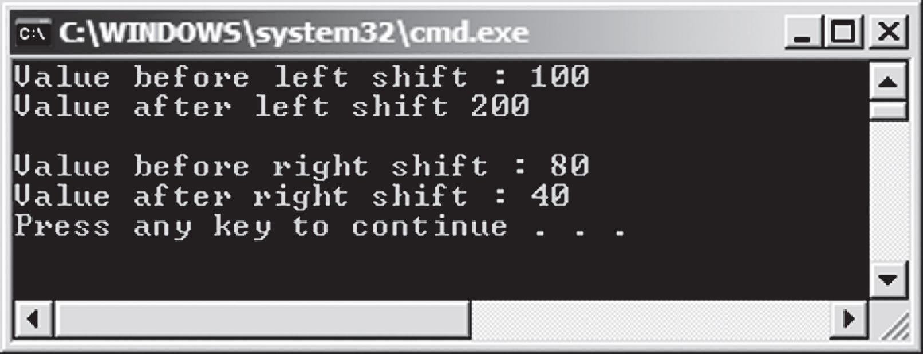
Shift Operators 2-2
In the code:
The Main() method of the class ShiftOperator performs the shifting operations.
The Main()method initializes the variable num to 100.
After shifting towards left, the value of num is doubled. Now, the variable num is initialized to 80.
After shifting towards right, the value of num is halved.
Following is the output of code:

Slide 38
String Concatenation Operator 1-2
The arithmetic operator (+) allows the programmer to add numerical values.
However, if one or more operands are characters or binary strings, columns, or a combination of strings and column names into one expression, then the string concatenation operator concatenates them. In other words, the arithmetic operator (+) is overloaded for string values.
The following code demonstrates the use of string concatenation operator.
using System;
class Concatenation
{
static void Main(string[] args)
{
int num = 6;
string msg = "";
if (num < 0)
{
msg = "The number " + num + " is negative";
}
else if ((num % 2) == 0)
{
msg = "The number " + num + " is even";
}
else
{
msg = "The number " + num + " is odd";
}
if(msg != "")
Console.WriteLine(msg);
}
}
Snippet

Slide 39
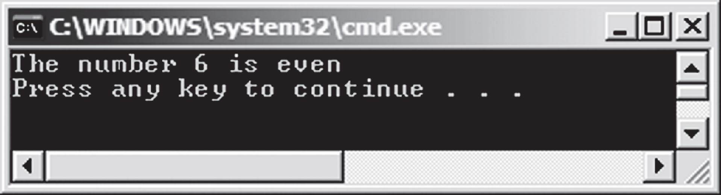
String Concatenation Operator 2-2
In the code:
The Main() method of the class Concatenation uses the construct to check whether a number is even, odd, or negative.
Depending upon the condition, the code displays the output by using the string concatenation operator (+) to concatenate the strings with numbers.
The output shows the use of string concatenation operator.

Slide 40
Ternary or Conditional Operator 1-3
The ?: is referred to as the conditional operator. It is generally used to replace the if-else constructs.
Since it requires three operands, it is also referred to as the ternary operator.
The first expression returns a bool value, and depending on the value returned by the first expression, the second or third expression is evaluated.
If the first expression returns a true value, the second expression is evaluated, whereas if the first expression returns a false value, the third expression is evaluated.
where,
Expression 1:Is a bool expression.
Expression 2: Is evaluated if expression 1 returns a true value.
Expression 3: Is evaluated if expression 1 returns a false value.
Syntax
<Expression 1> ? <Expression 2>: <Expression 3>;

Slide 41
Ternary or Conditional Operator 2-3
The following code demonstrates the use of the ternary operator.
Snippet
using System;
class LargestNumber
{
public static void Main()
{
int numOne = 5;
int numTwo = 25;
int numThree = 15;
int result = 0;
if (numOne > numTwo)
{
result = (numOne > numThree) ? result =
numOne :
result = numThree;
}
else
{
result = (numTwo > numThree) ? result =
numTwo : result = numThree;
}
if(result != 0)
Console.WriteLine("{0} is the largest number",
result);
}
}

Slide 42
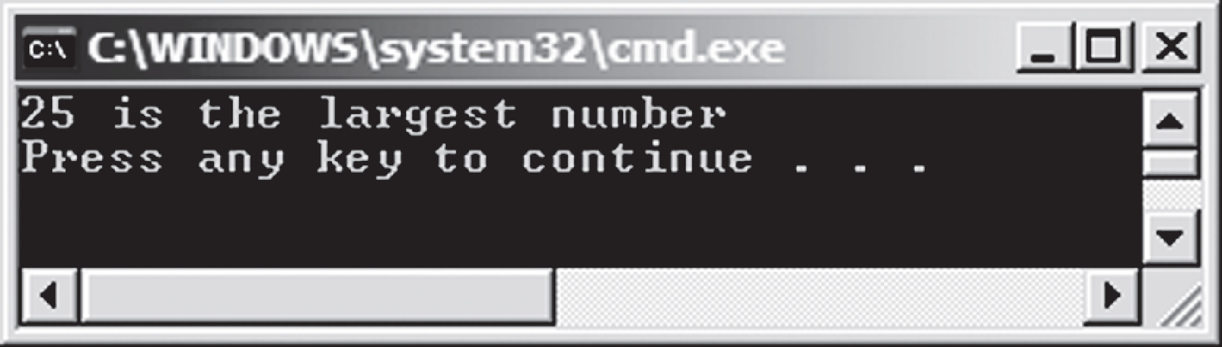
Ternary or Conditional Operator 3-3
In the code:
The Main() method of the class LargestNumber checks and displays the largest of three numbers, numOne, numTwo, and numThree.
This largest number is stored in the variable result.
If numOne is greater than numTwo, then the ternary operator within the if loop is executed.
The ternary operator (?:) checks whether numOne is greater than numThree. If this condition is true, then the second expression of the ternary operator is executed, which will assign numOne to result.
Otherwise, if numOne is not greater than numThree, then the third expression of the ternary operator is executed, which will assign numThree to result.
Similar operation is done for comparison of numOne and numTwo and the result variable will contain the larger value out of these two.
The following figure shows the output of the example using ternary operator:

Slide 43

Data Conversions in C#
Data conversions is performed in C# through casting, a mechanism to convert one data type to another.
Example
Consider the payroll system of an organization.
The gross salary of an employee is calculated and stored in a variable of float type.
The payroll department wants the salary amount as a whole number and thus, wants any digits after the decimal point of the calculated salary to be ignored.
The programmer can achieve this using the typecasting feature of C#, which allows you to change the data type of a variable.
C# supports two types of casting, namely Implicit and Explicit.
Typecasting is mainly used to:
Convert a data type to another data type that belongs to the same or a different hierarchy.
Display the exact numeric output. For example, you can display exact quotients during mathematical divisions.
Prevent loss of numeric data if the resultant value exceeds the range of its variable’s data type.

Slide 44
Implicit Conversions for C# Data Types – Definition
Implicit typecasting refers to an automatic conversion of data types. This is done by the C# compiler.
Implicit typecasting is done only when the destination and source data types belong to the same hierarchy.
In addition, the destination data type must hold a larger range of values than the source data type.
Implicit conversion prevents the loss of data as the destination data type is always larger than the source data type.
For example, if you have a value of int type, you can assign that value to the variable of long type.
The following code shows an example of implicit conversion.
In the code:
The compiler generates code that automatically converts the value in valueOne into a floating-point value before storing the result in valueTwo. Converting an integer value to a floating point value is safe.
int valueOne = 34;
float valueTwo;
valueTwo = valueOne;
Snippet

Slide 45
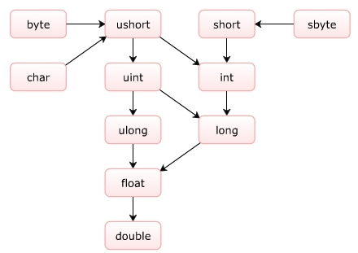
Implicit Conversions for C# Data Types – Rules
Implicit typecasting is carried out automatically by the compiler.
The C# compiler automatically converts a lower precision data type into a higher precision data type when the target variable is of a higher precision than the source variable.
The following figure illustrates the data types of higher precision to which they can be converted:

Slide 46
Explicit Type Conversion – Definition 1-2
Explicit typecasting refers to changing a data type of higher precision into a data type of lower precision.
For example, using explicit typecasting, you can manually convert the value of float type into int type.
This typecasting might result in loss of data because when you convert the float data type into the int data type, the digits after the decimal point are lost.
The following is the syntax for explicit conversion:
Syntax
<target data type><variable name> = (target data type)<source data type>;
where,
target data type: Is the resultant data type.
variable name: Is the name of the variable, which is of the target data type.
target data type: Is the target data type in parentheses.
source data type: Is the data type which is to be converted.

Slide 47
Explicit Type Conversion – Definition 2-2
The following code displays the use of explicit conversion for calculating the area of a square:
Area of the square = 110
Snippet
double side = 10.5;
int area;
area = (int)(side * side);
Console.WriteLine(“Area of the square = {0}”, area);
Output

Slide 48
Explicit Type Conversion – Implementation
There are two ways to implement explicit typecasting in C# using the built-in methods:
Using System.Convert class: This class provides useful methods to convert any built-in data type to another built-in data type.
Using ToString() method: This method belongs to the Object class and converts any data type value into string.
The code displays a float value as string using the ToString() method:
In the code:
The value of float type is converted to string type using the ToString() method. The string is displayed as output in the console window.
500.25
float flotNum = 500.25F;
string stNum = flotNum.ToString();
Console.WriteLine(stNum);
Snippet
Output

Slide 49
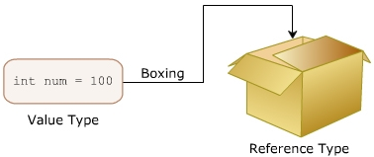
Boxing and Unboxing 1-6
Boxing is a process for converting a value type, like integers, to its reference type, like objects that is useful to reduce the overhead on the system during execution because all value types are implicitly of object type.
To implement boxing, you need to assign the value type to an object.
While boxing, the variable of type object holds the value of the value type variable which means that the object type has the copy of the value type instead of its reference.
Boxing is done implicitly when a value type is provided instead of the expected reference type.
The figure illustrates with an analogy the concept of boxing:

Slide 50
Boxing and Unboxing 2-6
The syntax for boxing is as follows:
where,
object: Is the base class for all value types.
instance of the object class: Is the name referencing the Object class.
variable of value type: Is the identifier whose data type is of value type.
The following code demonstrates the use of implicit boxing:
In the code:
Implicit boxing occurs when the value of double variable, area, is assigned to an object, boxed.
Area of the circle = 314
Syntax
object <instance of the object class> = <variable of value type>;
int radius = 10;
double area;
area = 3.14 * radius * radius;
object boxed = area;
Console.WriteLine(“Area of the circle = {0}”,boxed);
Snippet
Output

Slide 51
Boxing and Unboxing 3-6
The following code demonstrates the use of explicit boxing:
Snippet
float radius = 4.5F;
double circumference;
circumference = 2 * 3.14 * radius;
object boxed = (object)circumference;
Console.WriteLine(“Circumference of the circle = {0}”, circumference);
In the code:
Explicit boxing occurs by casting the variable, circumference, which is assigned to object, boxed.
Circumference of the circle = 28.26
Output

Slide 52
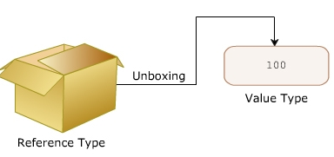
Boxing and Unboxing 4-6
Unboxing refers to converting a reference type to a value type.
The stored value inside an object is unboxed to the value type.
The object type must be of the destination value type. This is explicit conversion, without which the program will give an error.
The following figure illustrates with an analogy the concept of unboxing:
The syntax for unboxing is as follows:
where,
target value type: Is the resultant data type.
variable name: Is the name of the variable of value type.
target value type: Is the resultant value type in parentheses.
object type: Is the reference name of the Object class.
<target value type><variable name> = (target value type) <object type>;

Slide 53
Boxing and Unboxing 5-6
The following code demonstrates the use of unboxing while calculating the area of the rectangle:
In the code:
Boxing is done when the value of the variable area is assigned to an object, boxed. However, when the value of the object, boxed, is to be assigned to num, unboxing is done explicitly because boxed is a reference type and num is a value type.
Snippet
int length = 10;
int breadth = 20;
int area;
area = length * breadth;
object boxed = area;
int num = (int)boxed;
Console.WriteLine(“Area of the rectangle= {0}”, num);

Slide 54
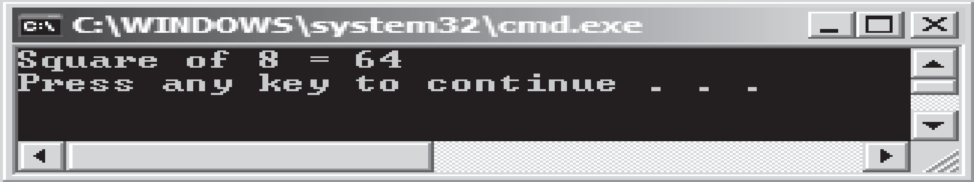
Boxing and Unboxing 6-6
The following code demonstrates how boxing and unboxing occur:
In the code:
The Main()method calculates the square of the specified value.
Boxing occurs when the variable num, which is of value type, is passed to the Square() method whose input parameter, inum, is of reference type.
Unboxing occurs when this reference type variable, inum, is converted to value type, int, before its square is returned to variable result.
The following figure shows the output of the code:
Snippet
using System;
class Number
{
static void Main(string[] args)
{
int num = 8;
int result;
result = Square(num);
Console.WriteLine("Square of {0} = {1}", num, result);
}
static int Square(object inum)
{
return (int)inum * (int)inum;
}
}
54

Slide 55
Summary
Statements are executable lines of code that build up a program.
Expressions are a part of statements that always result in generating a value as the output.
Operators are symbols used to perform mathematical and logical calculations.
Each operator in C# is associated with a priority level in comparison with other operators.
You can convert a data type into another data type implicitly or explicitly in C#.
A value type can be converted to a reference type using the boxing technique.
A reference type can be converted to a value type using the unboxing technique.

Slide 56

THANKS FOR WATCHING !

